Slide 1

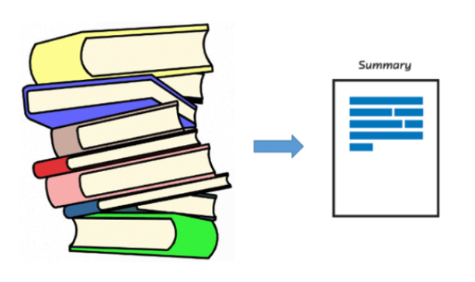
Text Summarization

Slide 2
Team Members
AbdEl-Rahman Sedky Mahmoud Medany
Mahmoud Eidarous
Mohamed Hatem
Ayed Ali Ayed
Hesham Tarek
Ahmed Tartoshy

Slide 3
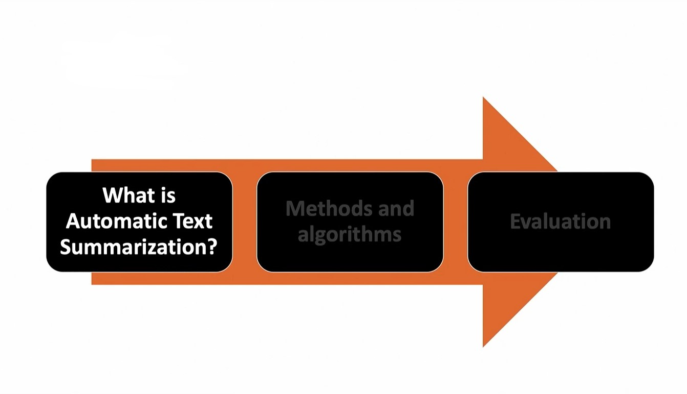

Slide 4
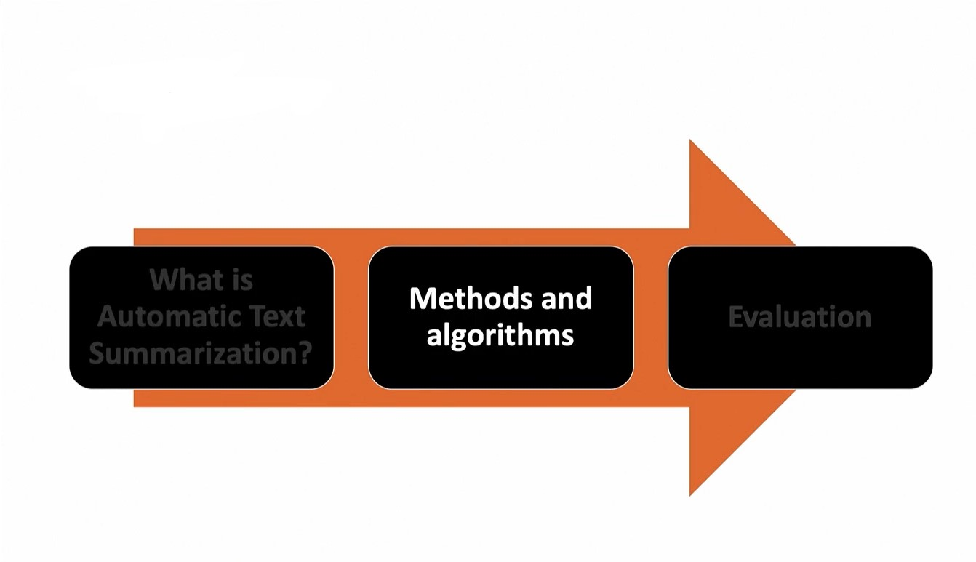

Slide 5
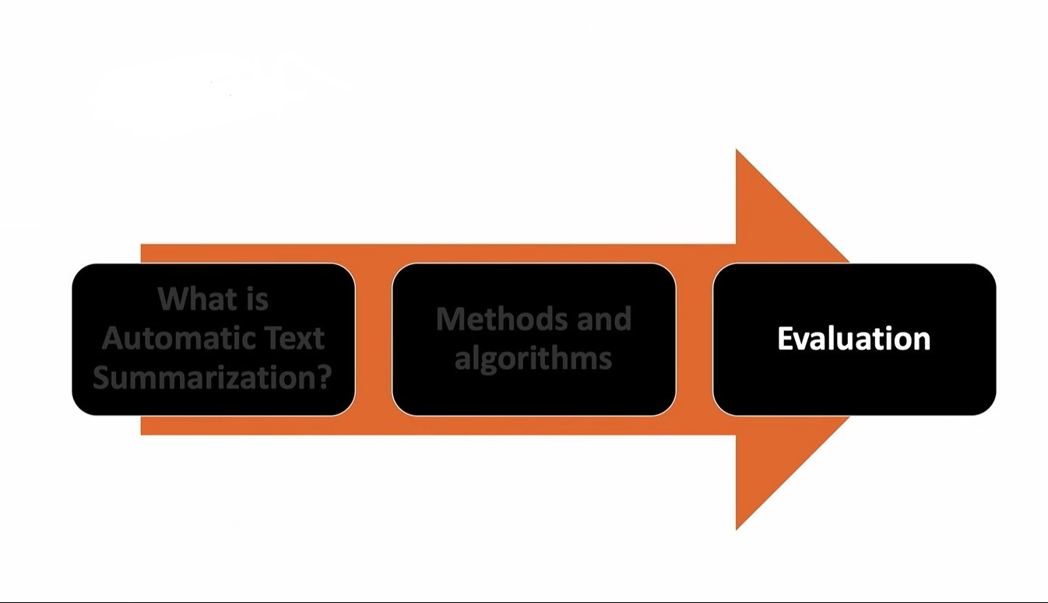

Slide 6

Of Course 30 minutes is not enough ,
So we are going to summarize summarization !

Slide 7
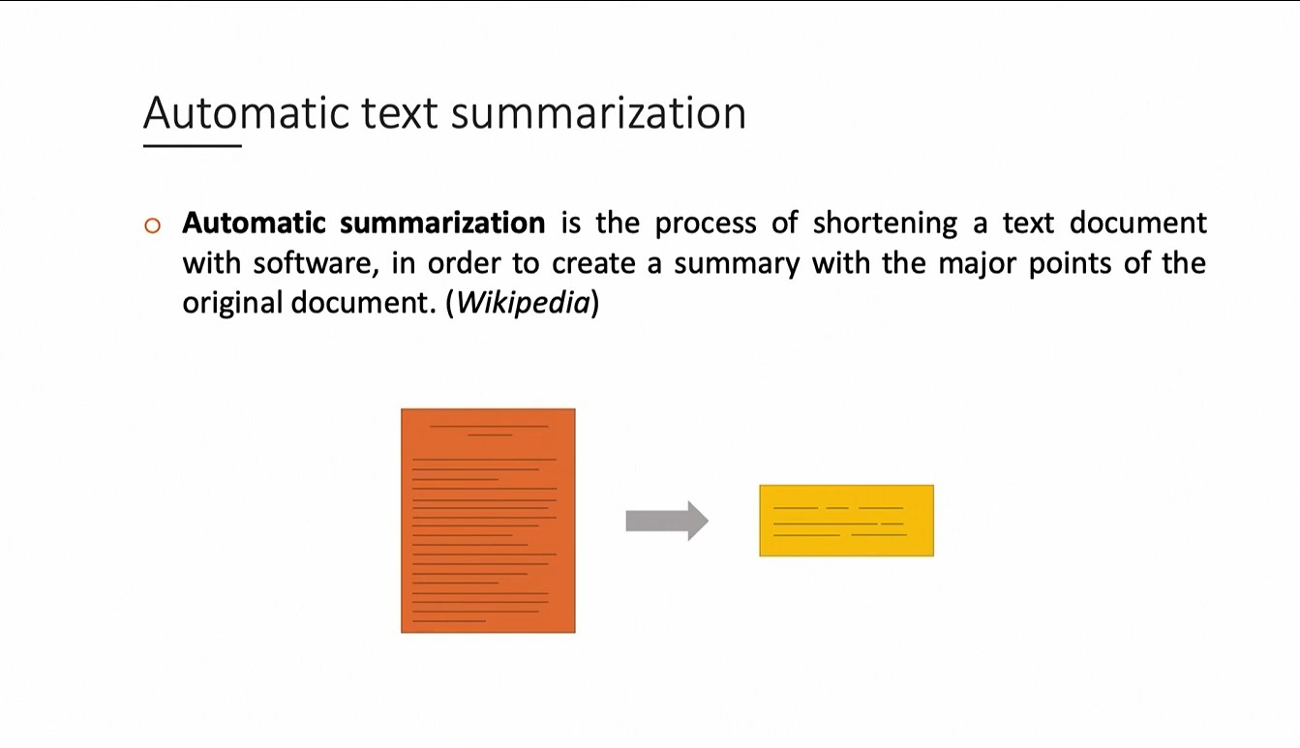

Slide 8
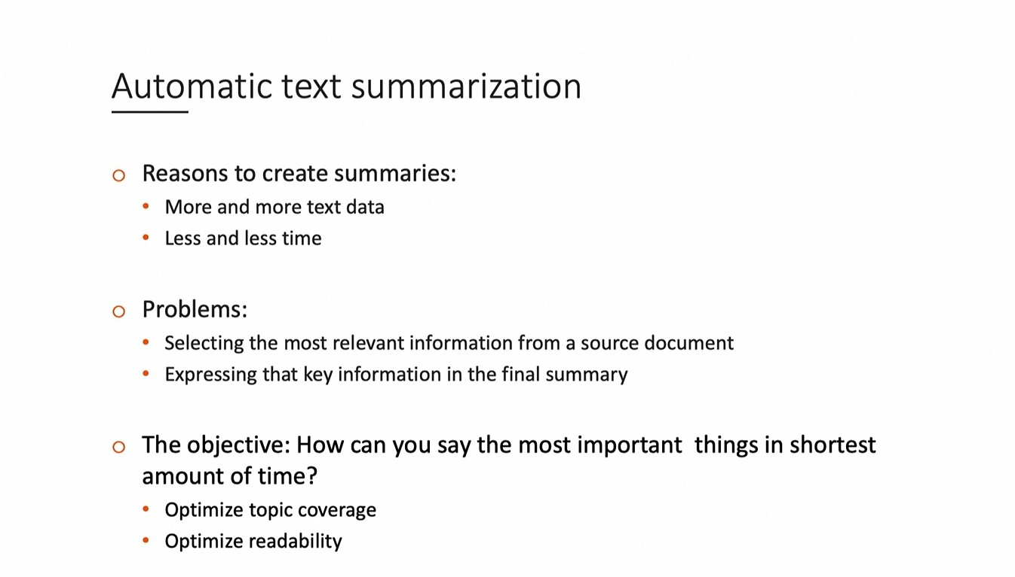
The New York Times publishes more than 150 articles a day and more than 250 on Sundays ,The Wall Street Journal publishes about 240 stories every day.

Slide 9
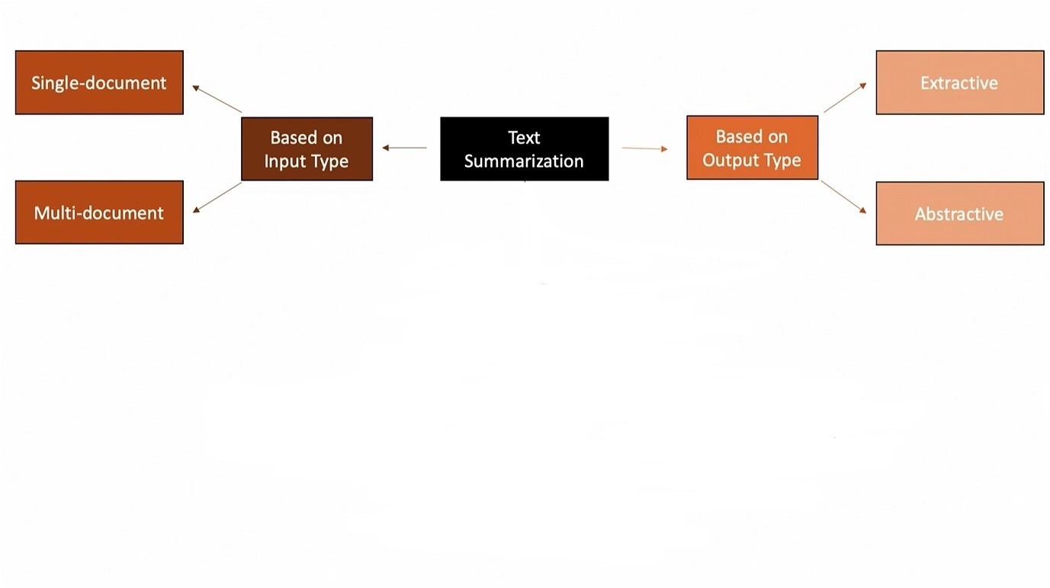

Slide 10
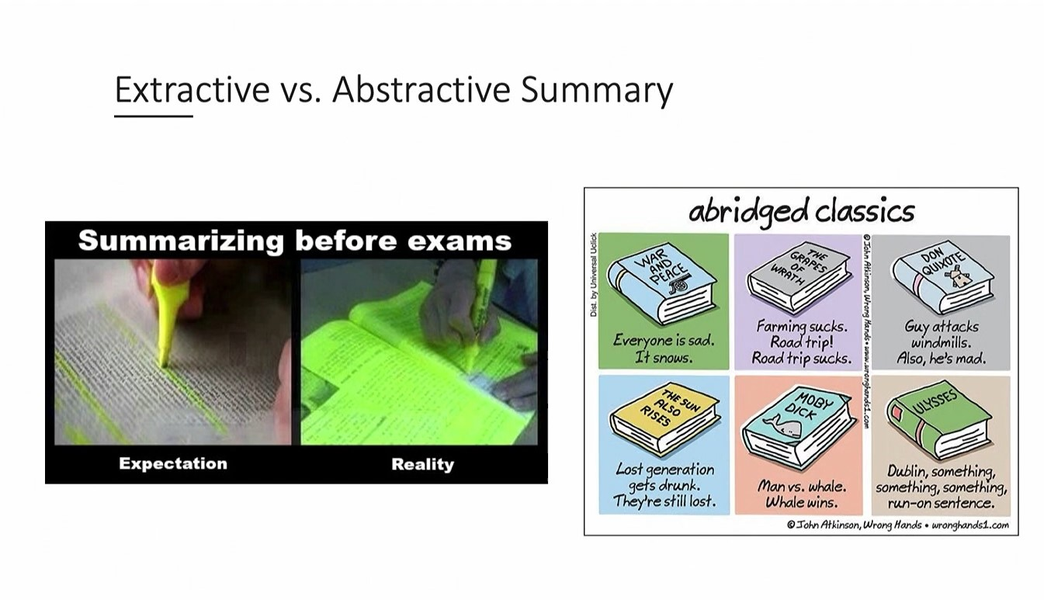

Slide 11
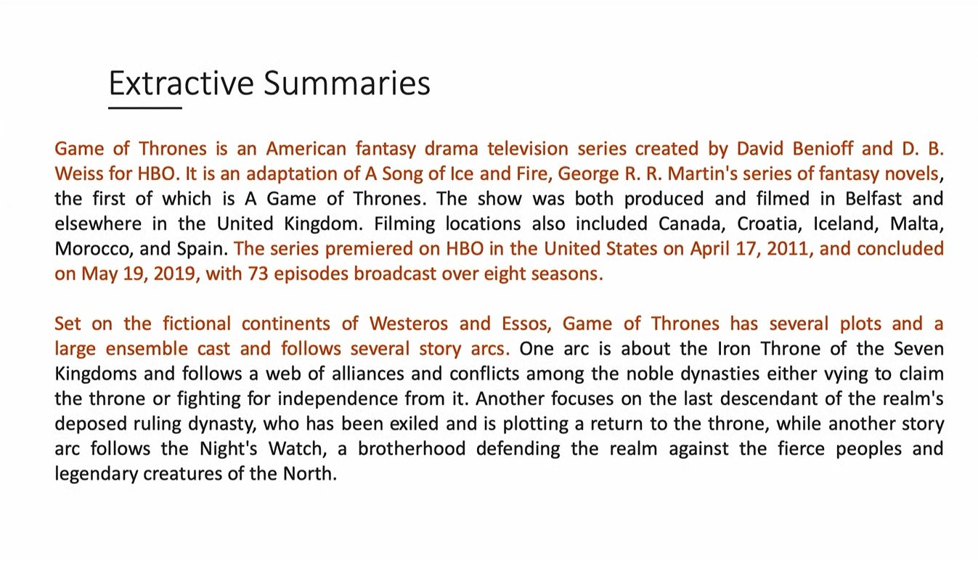

Slide 12
What about extractive summarization problems ?!

Slide 13


Slide 14
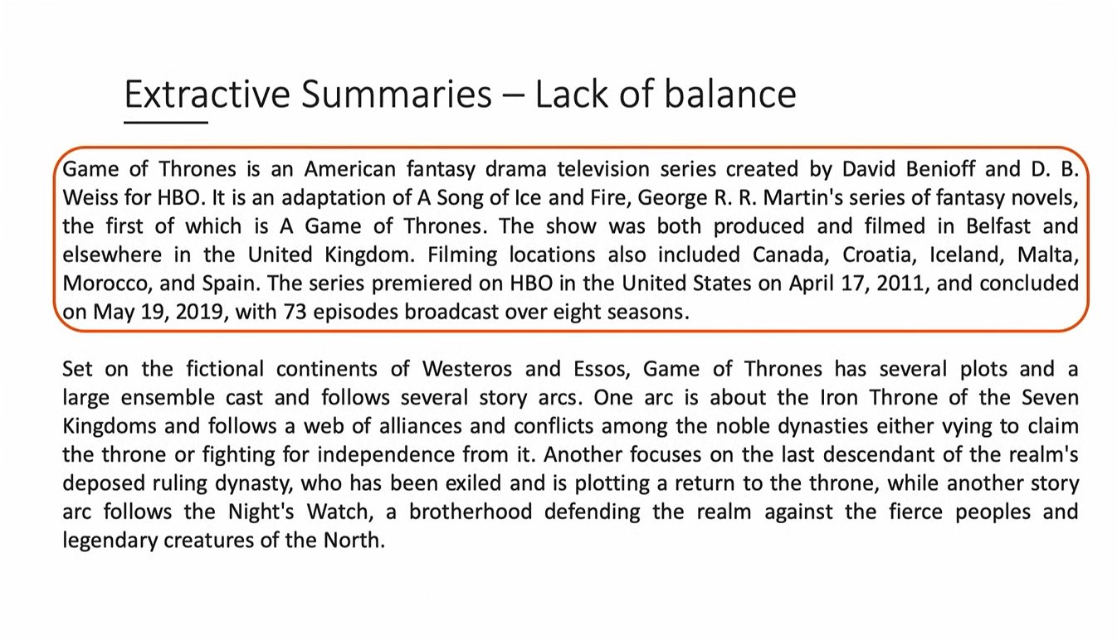

Slide 15
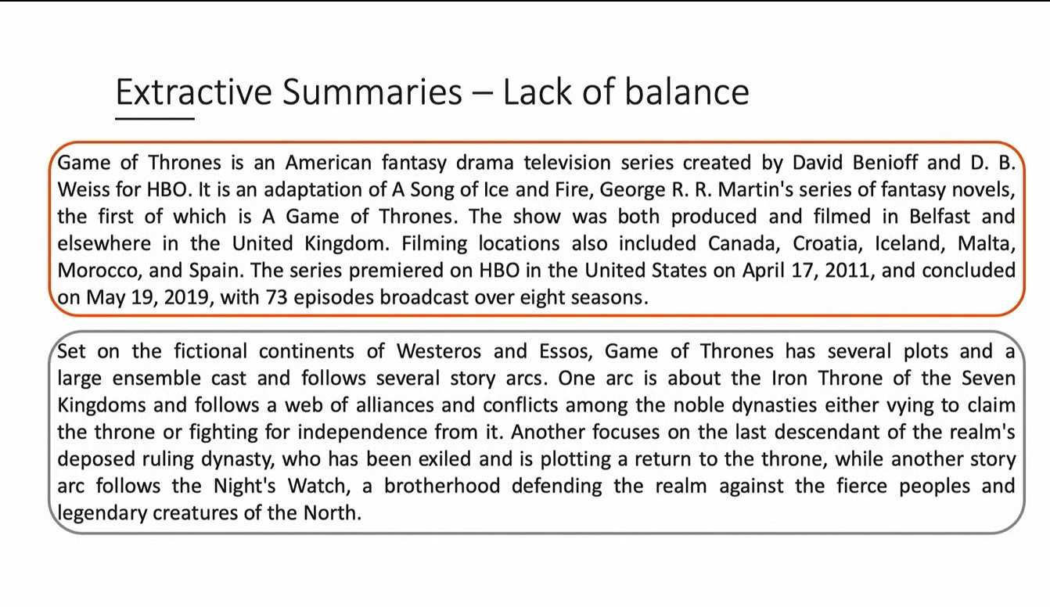

Slide 16


Slide 17
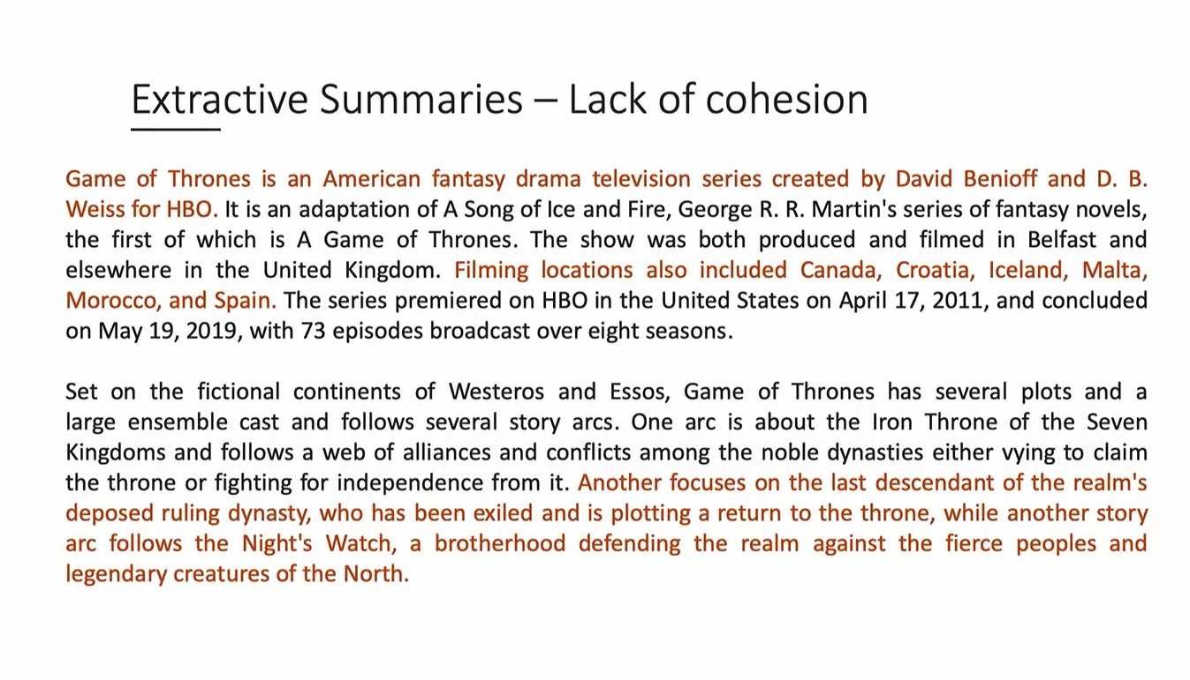

Slide 18


Slide 19
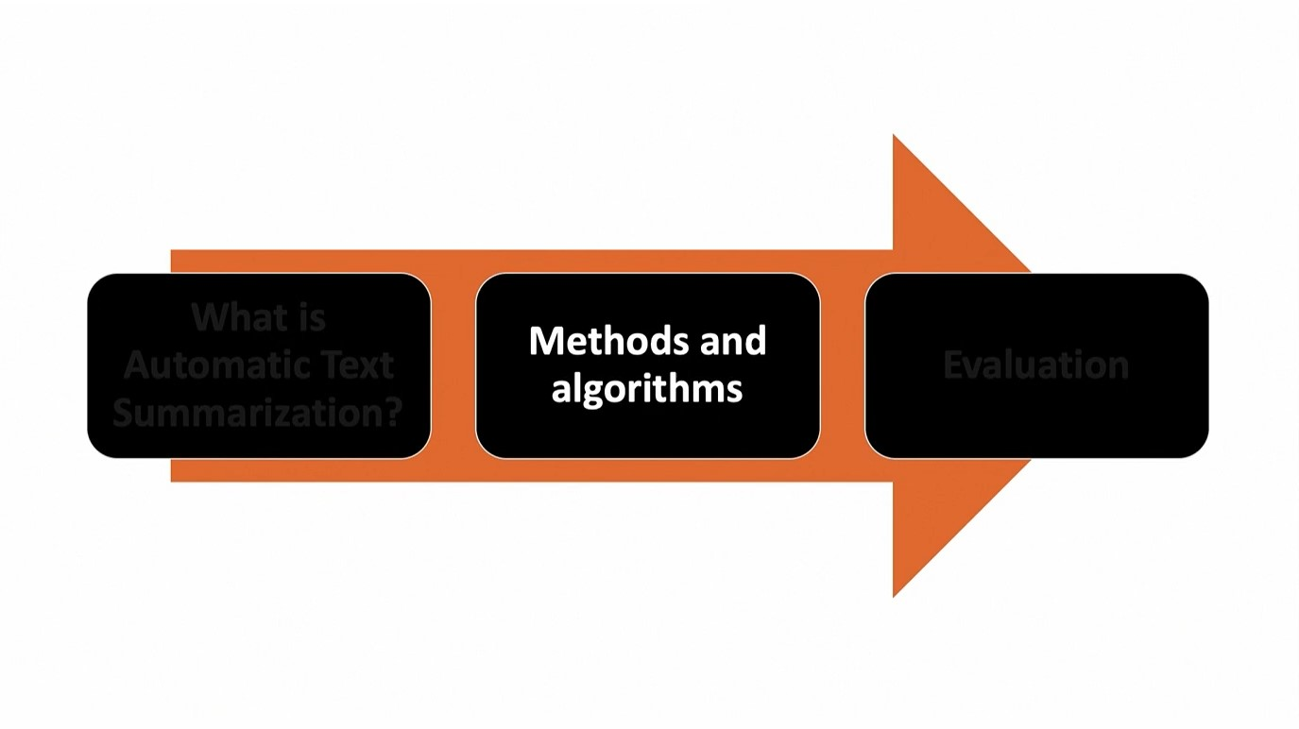

Slide 20
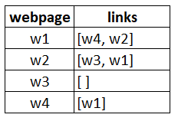
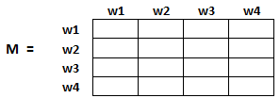
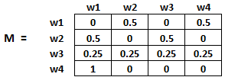
TextRank
Finds its roots associated with Google’s PageRank
Suppose we have 4 web pages
In order to rank these pages, we would have to compute a score called the PageRank score.
The initialization of the probabilities is explained in the steps below:
Probability of going from page i to j, i.e., M[ i ][ j ], is initialized with 1/(number of unique links in web page wi)
If there is no link between the page i and j, then the probability will be initialized with 0
if a user has landed on a dangling page, then it is assumed that he is equally likely to transition to any page. Hence,
M[ i ][ j ] will be initialized with 1/(number of web pages)

Slide 21
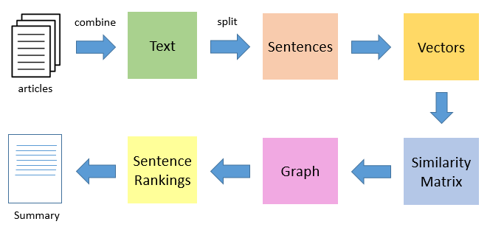
TextRank Algorithm
In place of web pages, we use sentences
Similarity between any two sentences is used as an equivalent to the web page transition probability
The similarity scores are stored in a square matrix, similar to the matrix M used for PageRank

Slide 22
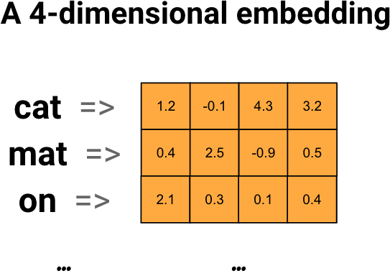
TextRank Algorithm
Tokenizing this paragraph into a list of sentences
Preprocessing is necessary
convert text data into numerical form
Calculate similarity between every two pairs of sentences
Convert the similarity matrix to a network/graph
Apply pagerank
create a dictionary {key:sentences , value: pagerank}
Lastly print top sentences ( no. of senstences we need )

Slide 23
Seq2Seq
RNN Limitations
Information bottleneck happens when the encoder tries to fit all info in one vector.
Hard to parallelize due to sequential nature.
Can't see both direction (even in BiDirectional) as every direction network sees in one direction only

Slide 24
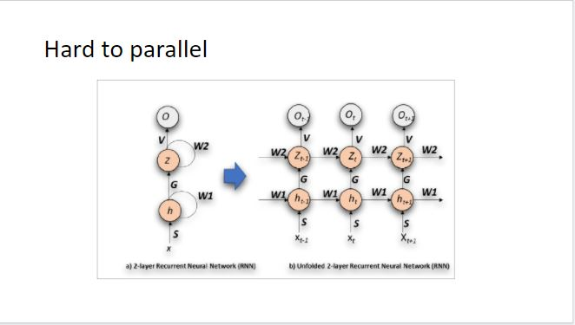

Slide 25
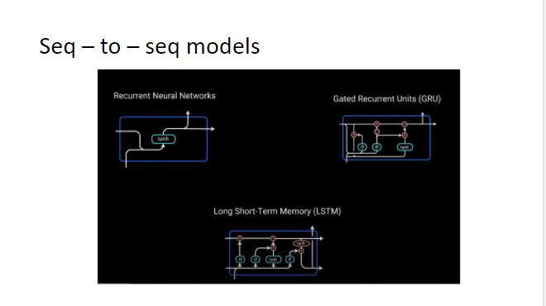

Slide 26
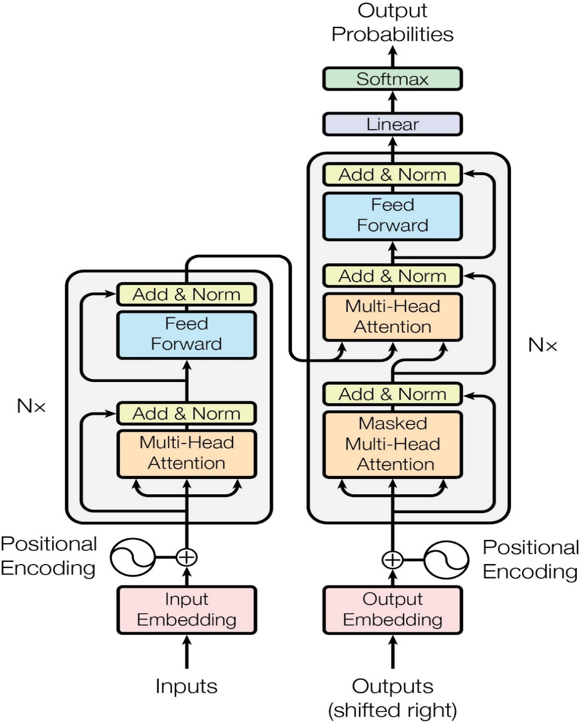
Transformer Architecture

Slide 27

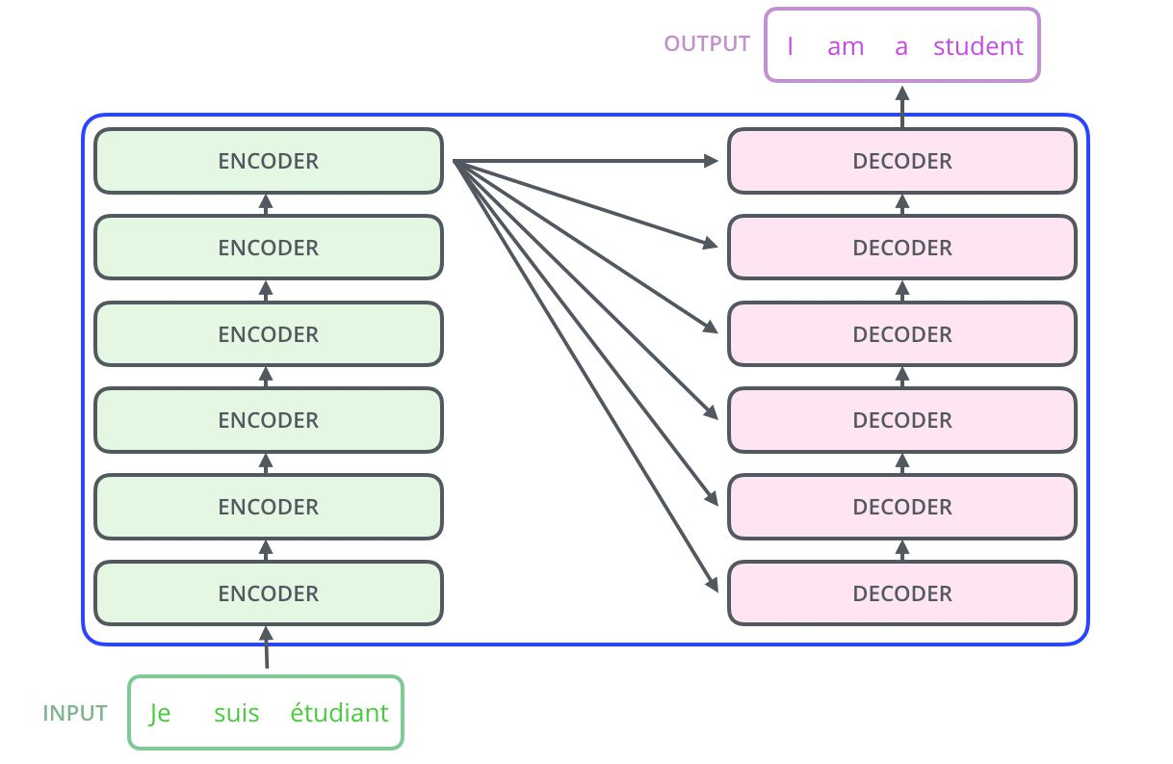
How Transformer Works

Slide 29

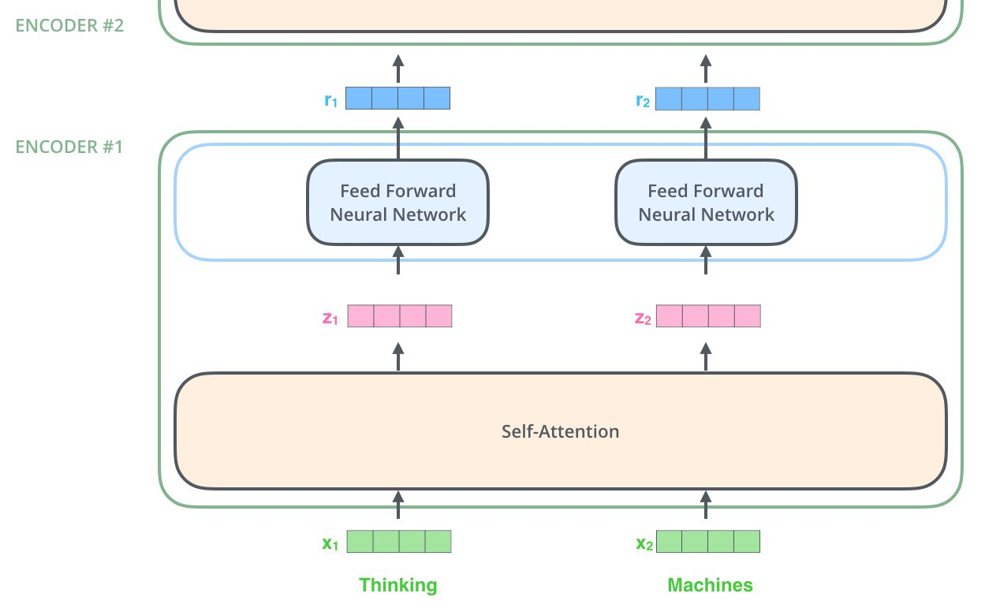
Encoder

Slide 30

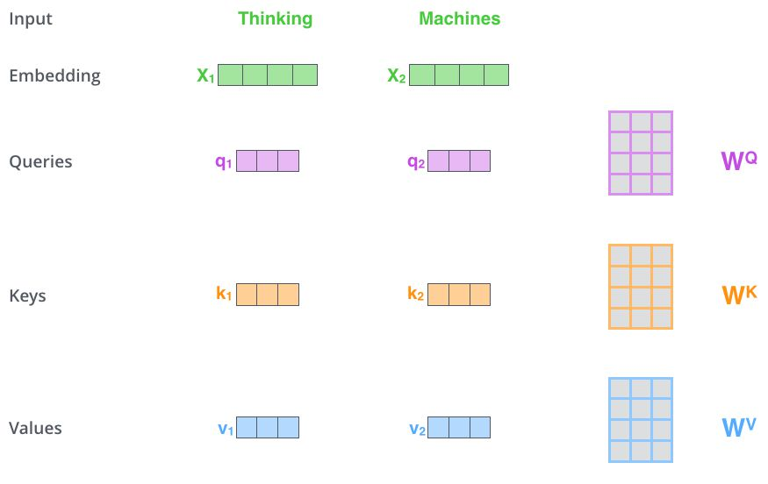
Self-Attention
It works by creating three vectors for each word.
Query, key and value.
Each one is created by a weights matrix that is learnable.
multiplying x by and W generates the corresponding vector.

Slide 31
Decoder
The decoder works exactly as the encoder expect for the mask.
Every future token is masked so the decoder can't attend to future tokens while training,
as they won't be available in inference.

Slide 32
Transformer Models

Slide 33
OpenAI: GPT
• It uses a stack of 12 decoder unit.
• No encoder is used.
• It trains on language modeling task.
• The objective is to predict the next word.
• The model is then used in downstream tasks.

Slide 34
Google: BERT
• Uses encoder instead of decoder.
• Trained on masked language modeling task,
BERT objective is to predict masked token.
• BERT can be used for almost every NLP task

Slide 35
Google: T5
• T5 was introduced by Google in early 2020, it's an encoder-decoder architecture.
• The model was trained on the Colossal Clean Crawled Corpus (C4) which is a huge corpus covering differing kind of tasks.
• The objective of the model is to fill the blank.

Slide 37
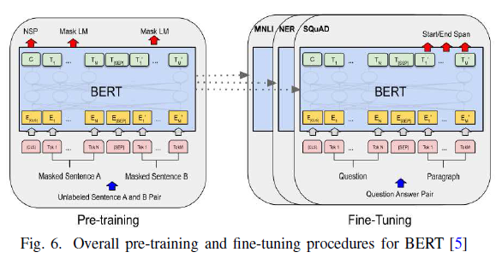
Transfer Learning Fine-Tuning

Slide 38
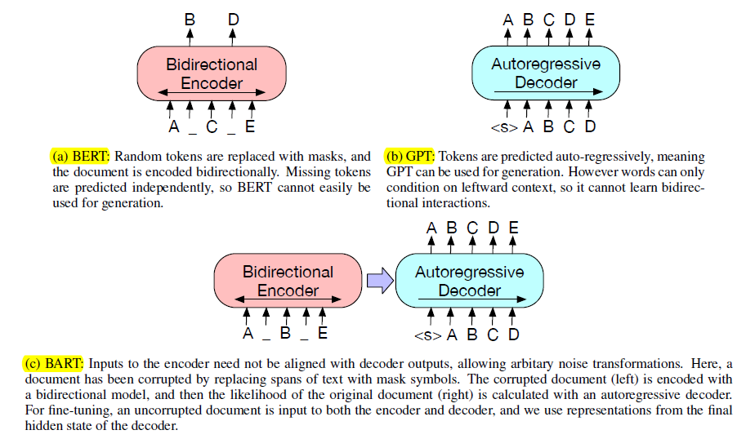
BART Transformer Pre-Trained Model
Base Model:
6 Encoders and 6 Decoder layers
Large Model:
12 Encoders and 12 Decoder layers

Slide 39
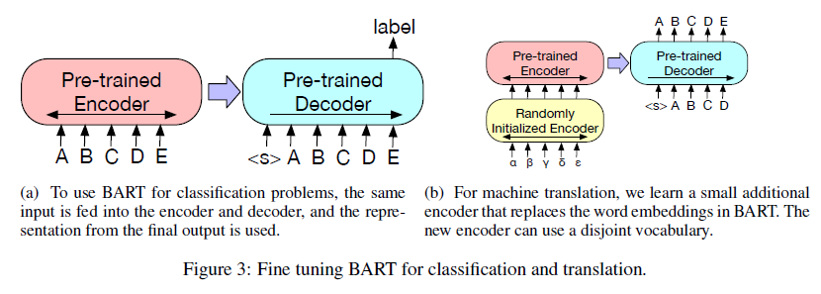
Fine-tuning BART
Can be used in several ways for downstream applications:
Classification tasks
Generation tasks
Machine translation (we replace BART’s encoder embedding layer with a new randomly initialized encoder. The model is trained end-to-end, which trains the new encoder to map foreign words into an input that BART can de-noise to English We train the source encoder in two steps )
Notes:
(we replace BART’s encoder embedding layer with a new randomly initialized encoder. The model is trained end-to-end, which trains the new encoder to map foreign words into an input that BART can de-noise to English We train the source encoder in two steps )

Slide 40
Distilled Models:
For BART, SFT produces distilled models that are 75% faster than their teacher with minimal loss in performance.
Distillation for Seq2Seq models has primarily used pseudo-labeling (PL) and produces strong results on machine translation.
Their approach consists of re-generating a new distilled dataset containing original source documents with pseudo-labels.
The pseudo-labels are summaries generated by the teacher using beam search. After the long dataset generation process

Slide 41
Shrink and Fine-Tune (SFT)
Simply shrinks the teacher model to student size and re-fine-tunes this student model.
A BART student with 3 decoder layers from the 12 encoder layer 12 decoder layer teacher, we copy the teacher’s full Enc and decoder layers 0, 6, and 11 to the student.
Direct Knowledge Distillation (KD) information is transferred from teacher to student, by encouraging the student to match the teacher’s full probability distribution over possible next words at each position

Slide 42
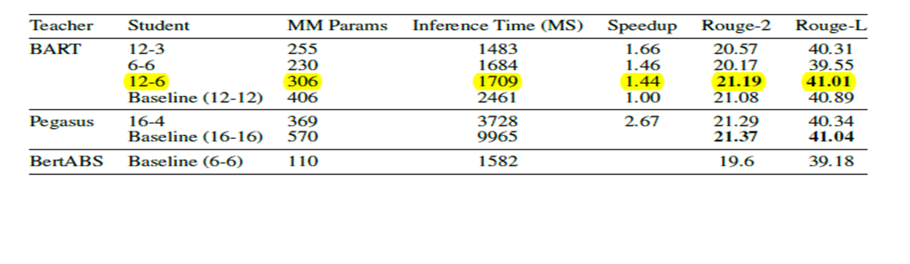
WHY DistillBART-CNN-12-16?

Slide 43
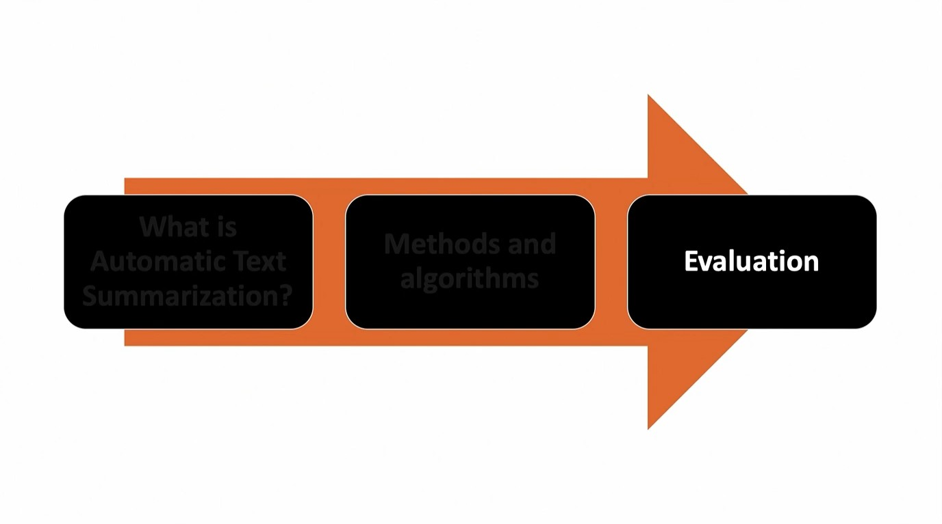

Slide 44
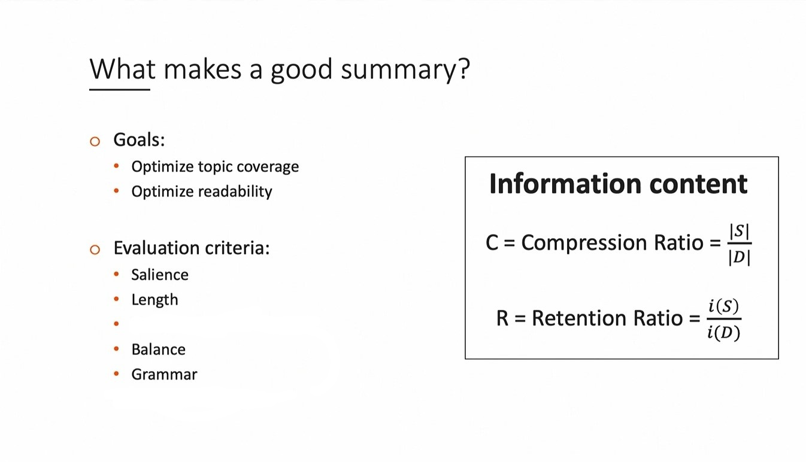
Non-redundancy

Slide 45
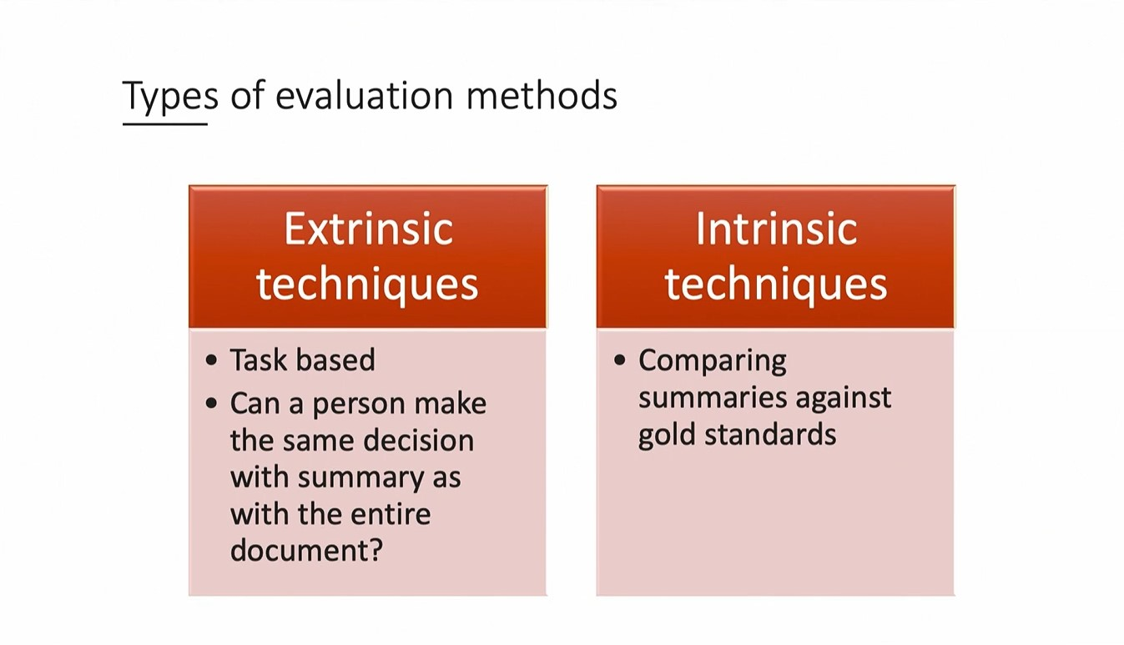

Slide 46
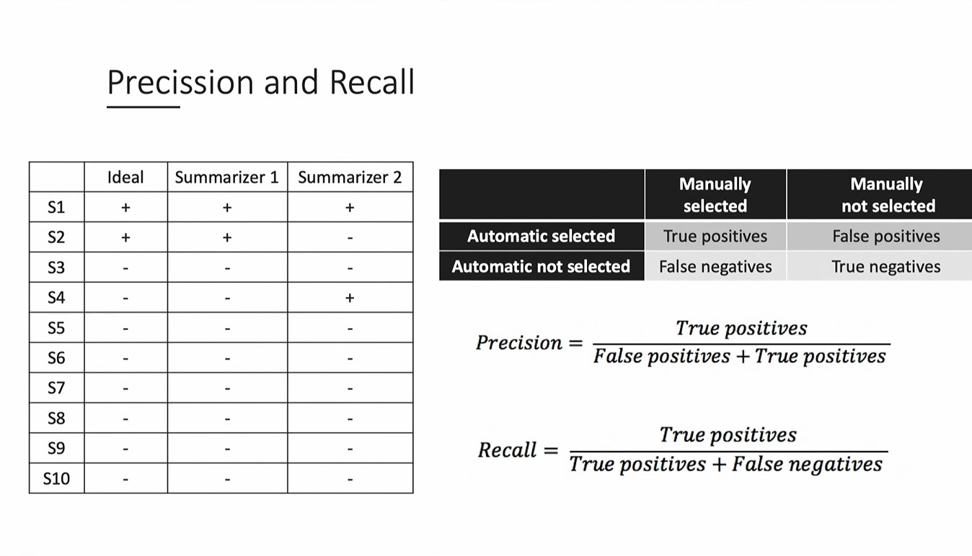

Slide 47
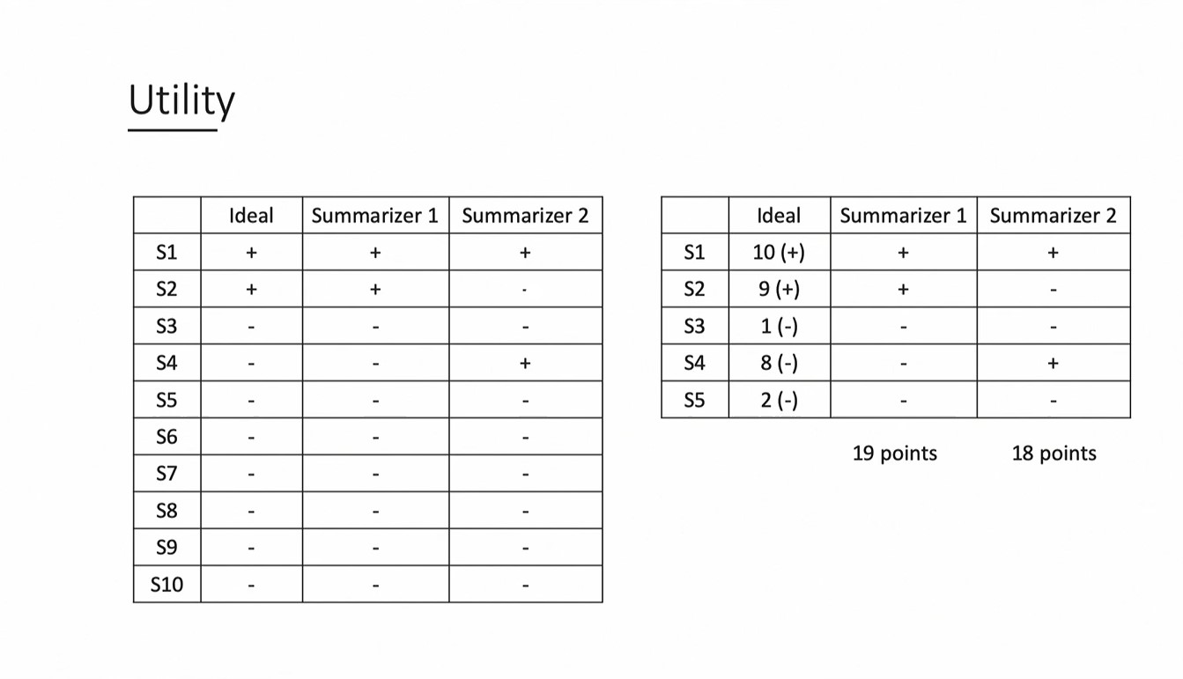

Slide 48
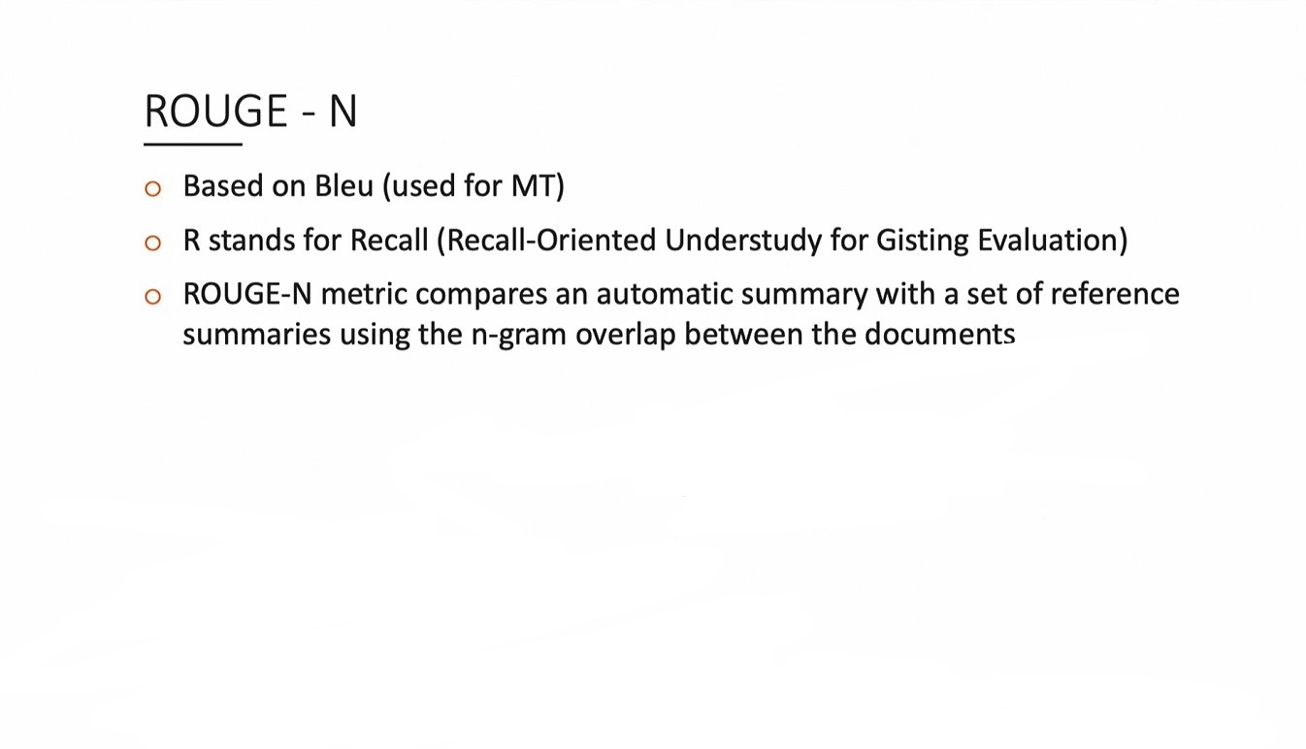

Slide 49
Web Scraping:
Scraping Techniques :
Selenium
Beautiful Soup
Scrapy

Slide 50
Beautiful Soup
Pipline :
Scraping request
Scraping Parameters
Joining Sentences

Slide 51
DEMO

Slide 52
API features
Summarize by Text as an input
Summarize by URL as an input
Control the length of summary output
Control beam search size
Display time taken in each process
Measure input and output length
Long text handling

Slide 53

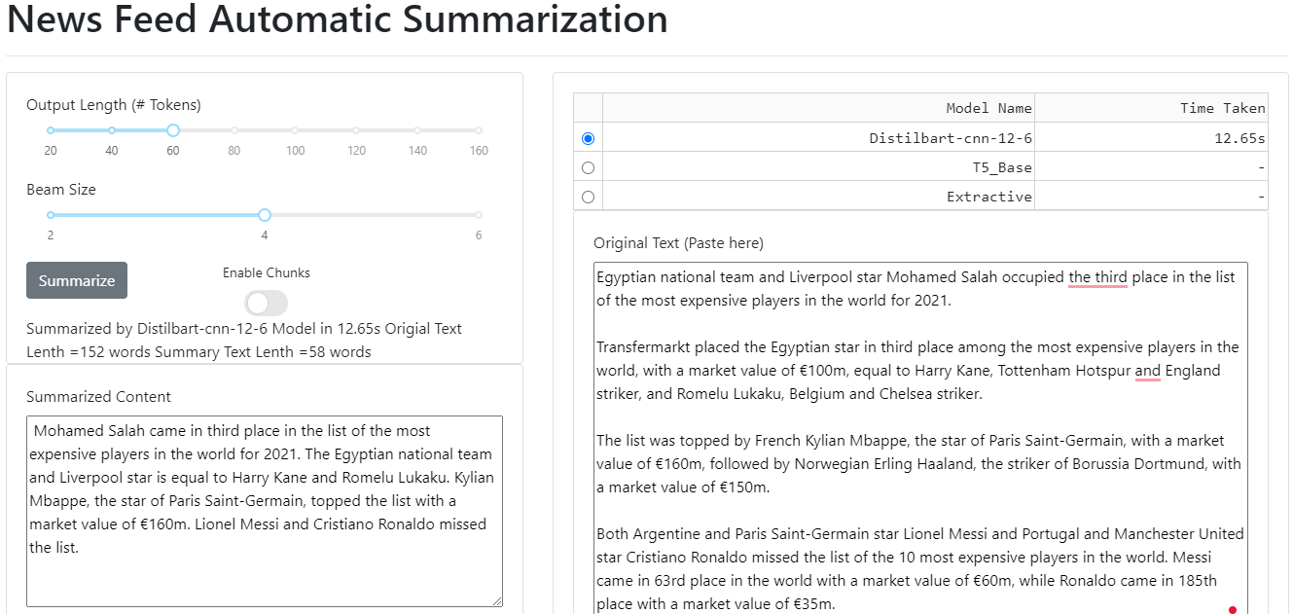

Slide 54
Conclusion
Distilbart-cnn-12-6 model gave wonderful results and created a sound and fluent summary for a given text document
T5 only good in short text document
We can overcome text length limitation in any model using chunking technique

Slide 55
Future work
A hybrid of the pre trained models can be used to improve the accuracy, fluency, and coherence of the summaries.
Trying to build pipeline using both extractive and abstractive methods to give better results on long text
Building recommender system to suggest similar news
Web browser extinction to auto summarize

Slide 56
References
arXiv:2104.11230v1 [cs.CR] 23 Apr 2021
arXiv:2010.13002v2 [cs.CL] 28 Oct 2020
arXiv:1910.01108v4 [cs.CL] 1 Mar 2020
arXiv:1910.10683v3 [cs.LG] 28 Jul 2020
arXiv:1910.13461v1 [cs.CL] 29 Oct 2019
arXiv:1810.04805v2 [cs.CL] 24 May 2019
arXiv:1706.03762v5 [cs.CL] 6 Dec 2017

Slide 57


